Slide 1

Data Discovery with SQL: From Queries to Clarity
Josselyn Ngonde-joana
Naïm Mokrane
Héctor Córdova

Slide 2
Agenda
Database 1
insights
queries
Database 2
queries
recommendation
Database 3
queries
business value
Reflection

Slide 3
Database 1 tasks
classicmodels

Slide 4



Insights
How can we know the current state of the business?
Business is growing year over year not only in orders placed but in number of customers
President and VP,
Top management
The company shows productivity; therefore, we can focus on growth directed strategies.
We should find if orders are growing over time, since orders imply revenue
Is client base growing at the same pace?
February could be key in operational efficiency while Q4 may present some challenges or bottlenecks. This suggest the business may present some seasonality.
VP Sales,
Sales Managers, Sales Reps
Tracking shipment delay is essential for resource allocation and optimizing operation.
Are there any potential issues in our operation?

Slide 5
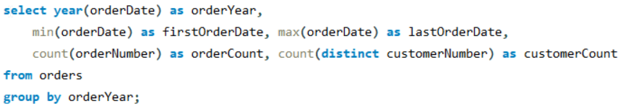
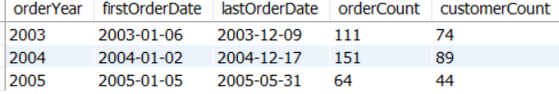
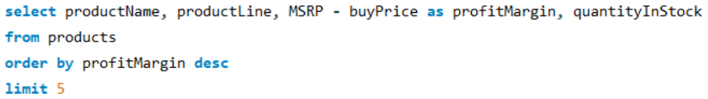
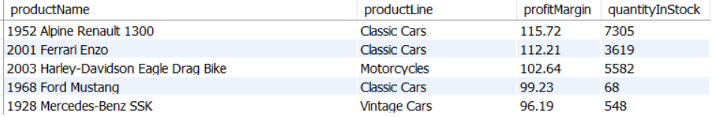
Aim of the queries
Task 1.1 – Single Table
Query 1: Show evolution of our Orders and Profit or Sales year over year
Query 2: Find top 5 products with the highest profit margin (MSRP - buyPrice)

Slide 6
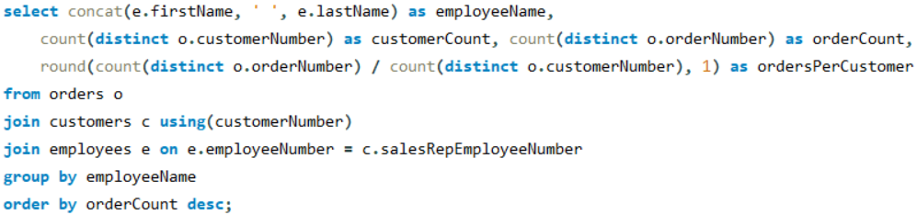
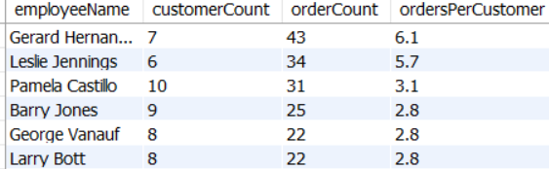
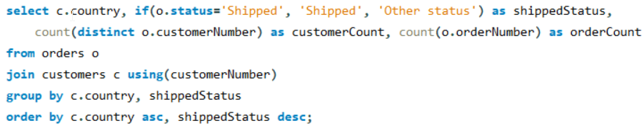
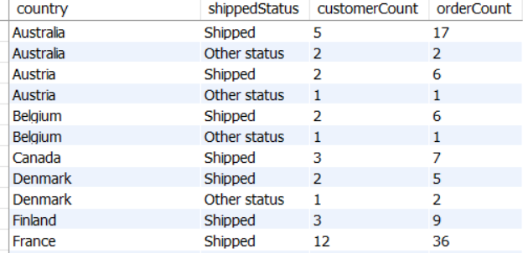
Task 1.2 – Queries using JOIN
Query 1: Find how many customers are assigned to an employee, how many orders have been placed, then calculate the average regardless if the order was Cancelled
Query 2: Check the number of orders and customers, by country and grouping by Shipped or have other Status

Slide 7
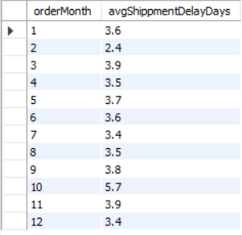
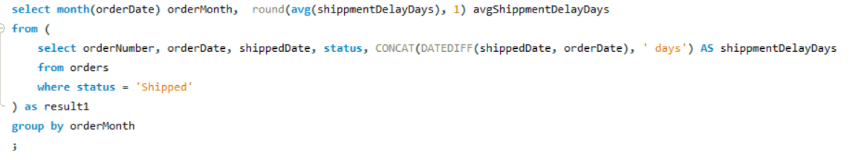
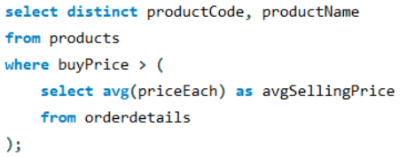
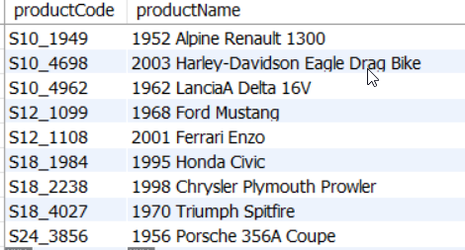
Task 1.3 – Subqueries
Query 1: Calculate the average time an order takes to be shipped and find
out if a specific month present significantly more or less delay than other
Query 2: Identify Products Codes that are above the Selling Price average

Slide 8
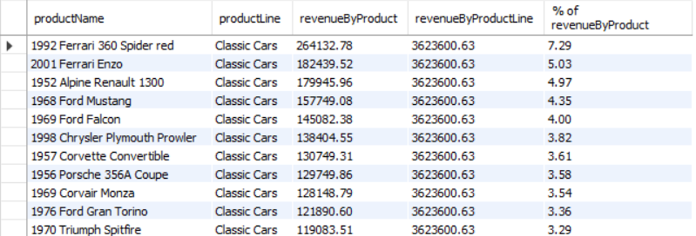
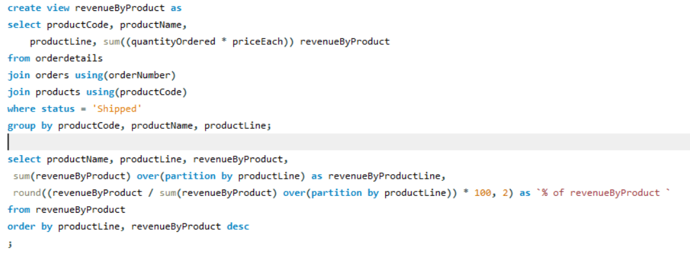
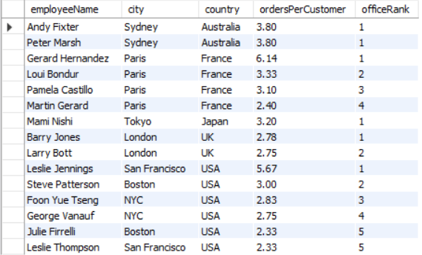
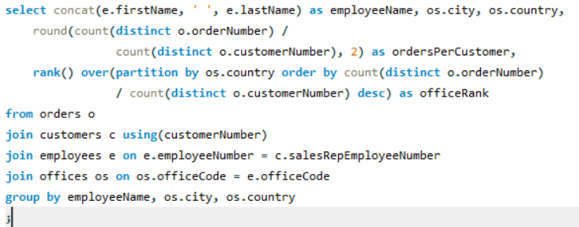
Task 1.4 – Window functions
Query 1: Compute the revenue by product and then the % that this product occupy within its product line
Query 2: Check the number of orders and customers, and rank employees by office

Slide 9
Database 2
teamproject

Slide 10

Recommendations
1. Implement Incentives for Renewable Energy Adoption
German Government
The low renewable energy contribution score highlights opportunities to improve its share in total energy consumption and reduce carbon emissions
2. Share Best Practices in Recycling
Germany’s strong recycling practices can inspire Europe. By sharing expertise and collaborating, it can enhance carbon reduction strategies and benefit from mutual knowledge
German Government

Slide 11
Database 3
Airline satisfaction survey
Kaggle.com

Slide 12
Relevance of the dataset
Real world data
Aligns with teams’ interest
Rich dataset
It can tell us about preferences and features that are relevant for customer satisfaction and can lead to a better customer journey, from pre-purchase to end of flight.
All members of the team are interested in working in the private sector and this is a good opportunity to practice what we have learned in a dataset we might encounter in the future.
Multiple variables and a lot enrichment possibilities. Insights not easy to come across useful for applying some SQL operators.

Slide 13
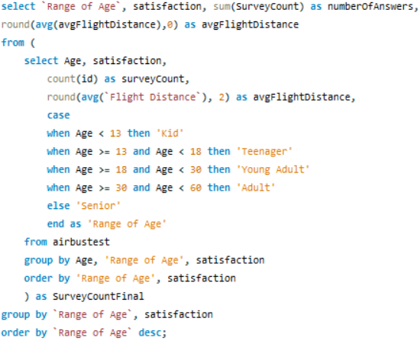
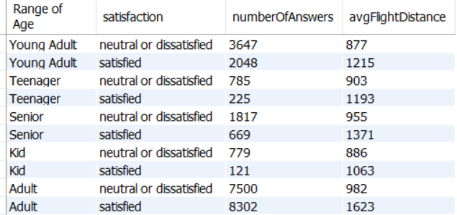
Task 3.2 – Business value of our query of choice
Query 1: Calculate the customer satisfaction respondents and average flight distance by age group, and satisfaction category

Slide 14


Business value
By leveraging this data, the airline can target specific customer segments with tailored initiatives.
The main objectives can be:
To improve the flight experience for dissatisfied groups long-term increase their average booking value
Engage with satisfied customers can be further engaged to increase loyalty and retention as long-term strategy.
There is a particularly interesting opportunity in the ‘Young adult’ category, as they represent a high number of respondents for an age group spanning only 12 years. Enhancing the experience of these customers could see them converted into frequent, high-value customers for decades to come.

Slide 15
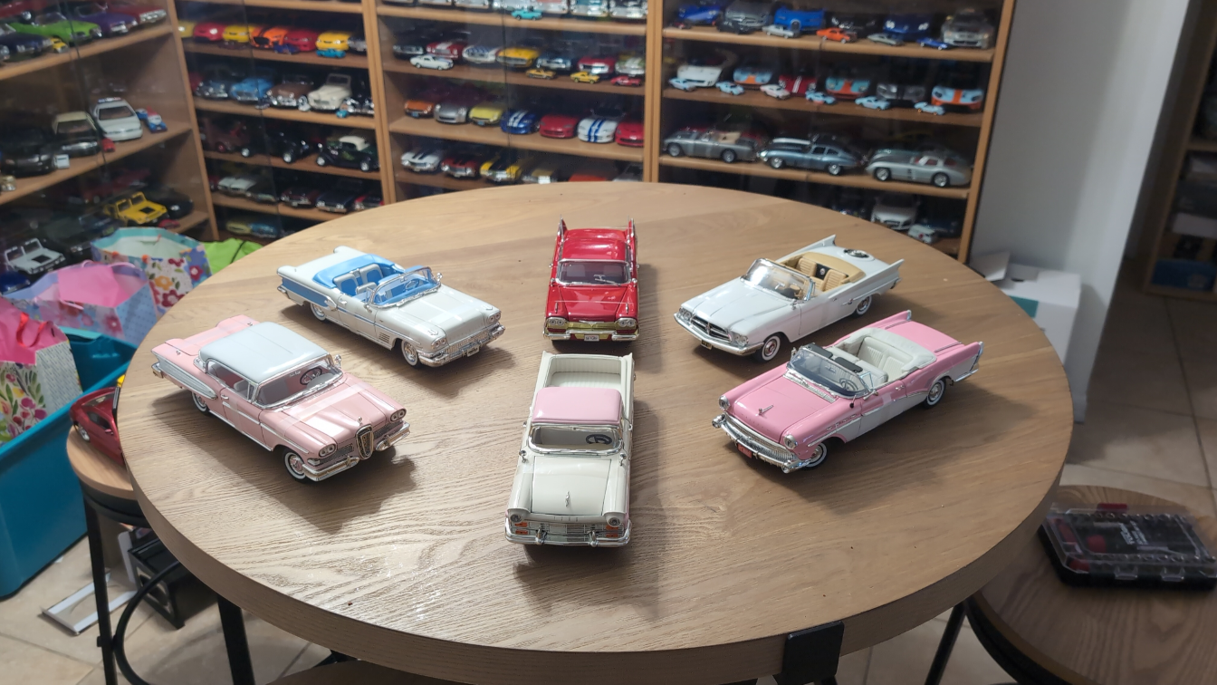



Thank you

Slide 16



Reflection What we learned
Finding the business value
Context is important
New SQL functions
Knowing SQL is nice, but we struggled to find actual meaning to the data and how can it benefit the business
We had to take some time to understand the data,
mainly for the second task and had to use the external data resources provided.
As we progressed, we had to look for usages we weren’t familiar with like ‘if’, ‘case’, ‘concat’ that helped us enrich our output.

